Slide 1

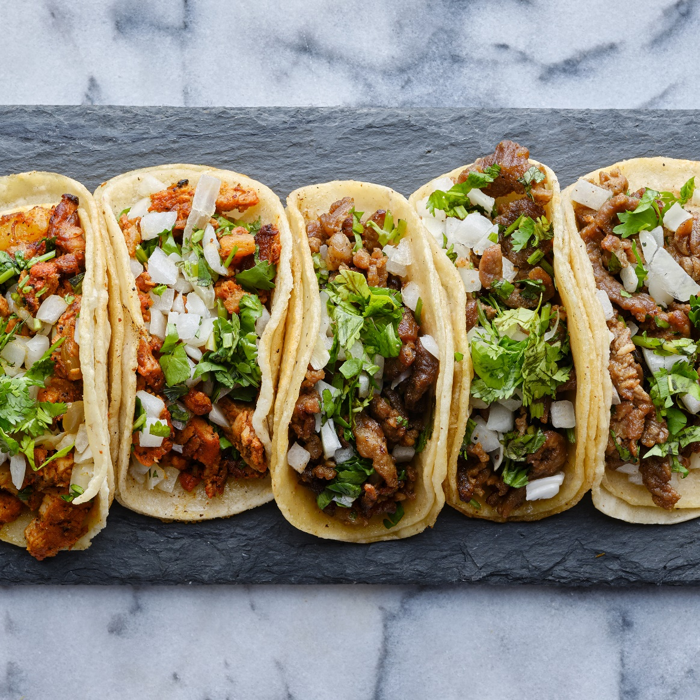
ONLINE FOOD ORDERING SYSTEM
Foodie’s Favorite
BY
Bejagama Chandana
202217b2131

Slide 2

CONTENTS
INTRODUCTION
OBJECTIVES
USER INTERFACE (UI)
STEPS TO LOGIN OUR WEBSITE
BENEFITS OF ONLINE FOOD ORDERING
CONCLUSION

Slide 3
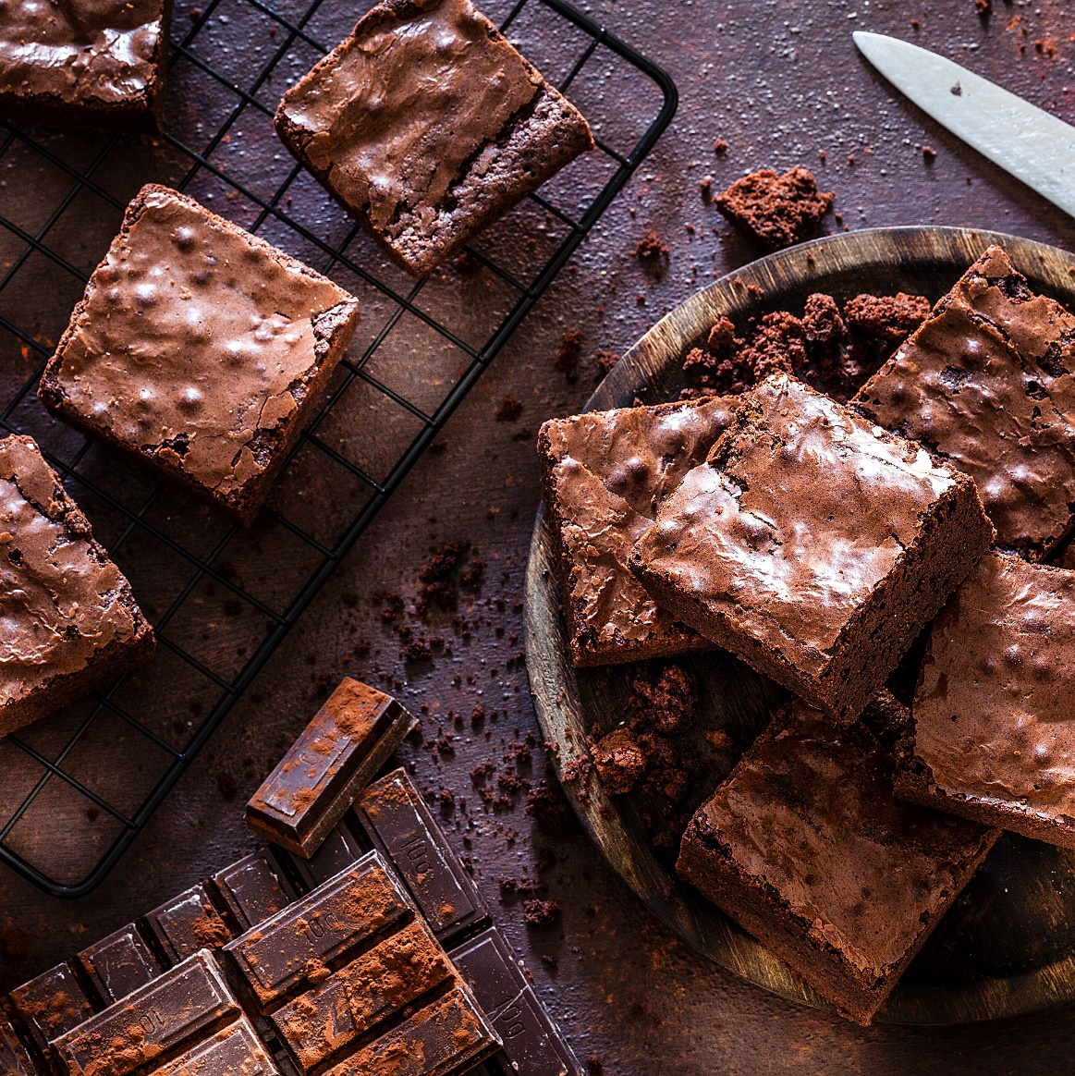
INTRODUCTION
An online food ordering system that is internet based makes ordering food easier for customers and restaurant processes easier to manage on the whole. Users with this system can look at a menu, make their orders as per their preferences, and make payment over the web ensuring that, convenience is achieved and waiting time cut down. On the other hand, in an efficient manner, the system helps restaurants in handling the orders via an administrative interface which keeps the record of orders, inventory and customer details. Besides, this platform is very user-oriented as it allows to do all the above in real time, for example allowing the user to see the status of their order. Web-based food ordering systems such as marketing services to attract customers, collecting customer feedback, and offering discounts for the customers' best rate, positively influence the customers, the restaurant, and the ways of doing business in modern days.
\

Slide 4
The main objective of this system is to manage the details of item category, food, delivery address, order, and shopping cart. The purpose is to build and application program to reduce the managing the item category, food customers. It tracks all the delivery address ordered. As it is online the customer doesn't have to wait for the waiter to take their order and doesn't us to wait for the food as well Waiters don't have to manually keep a record of all the food ordered by the customer and that work is very easy. Waiters don't have to manually calculate the amount of money to be paid by the customer after having food it is automatically done in the software. Records are maintained in computers so there are less chances of damage and loss of data More exposure for people in the world of technology.
OBJECTIVES

Slide 5
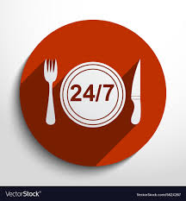
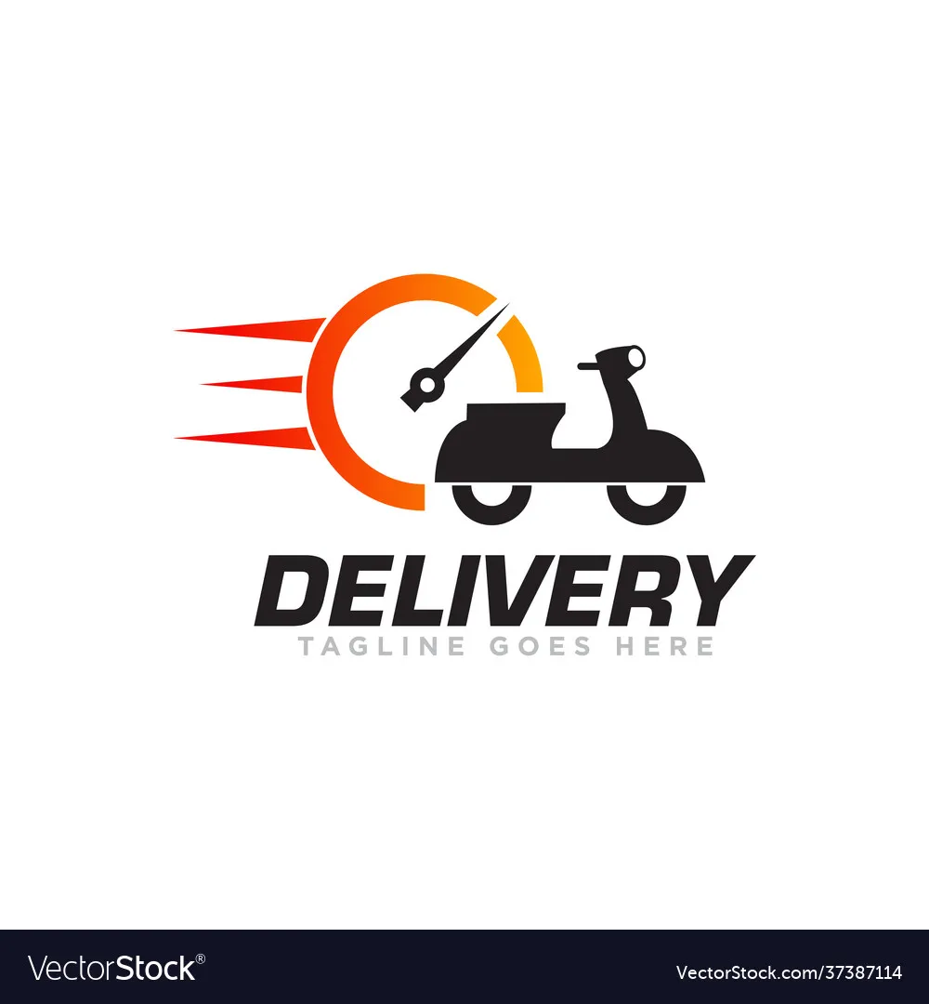
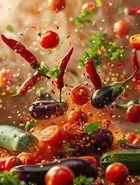
27/7 Service on online
Fastest Delivery to your address
Food made with Fresh Ingredients

Slide 6
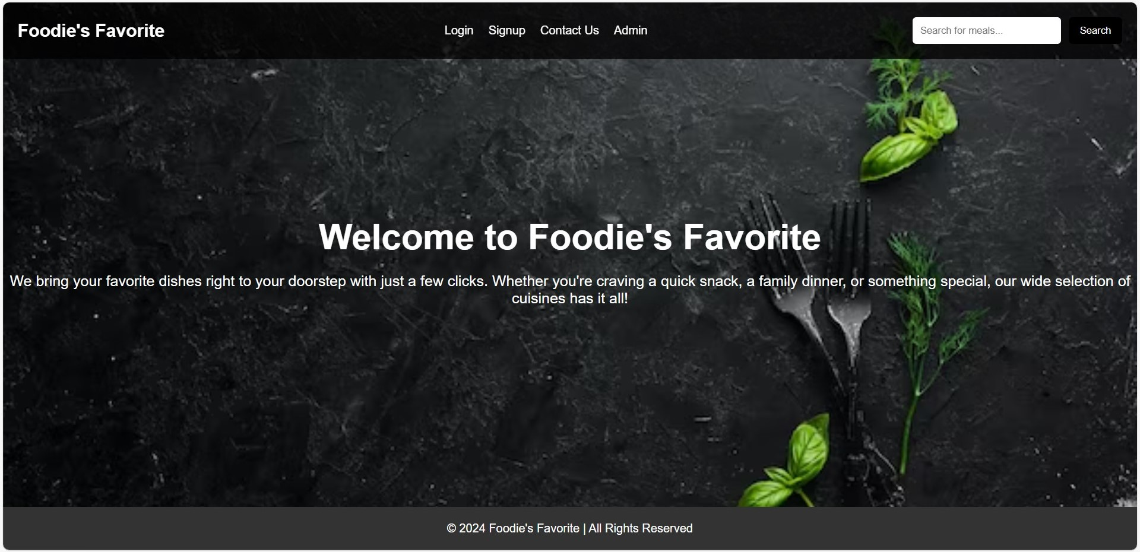
Welcome Page

Slide 7
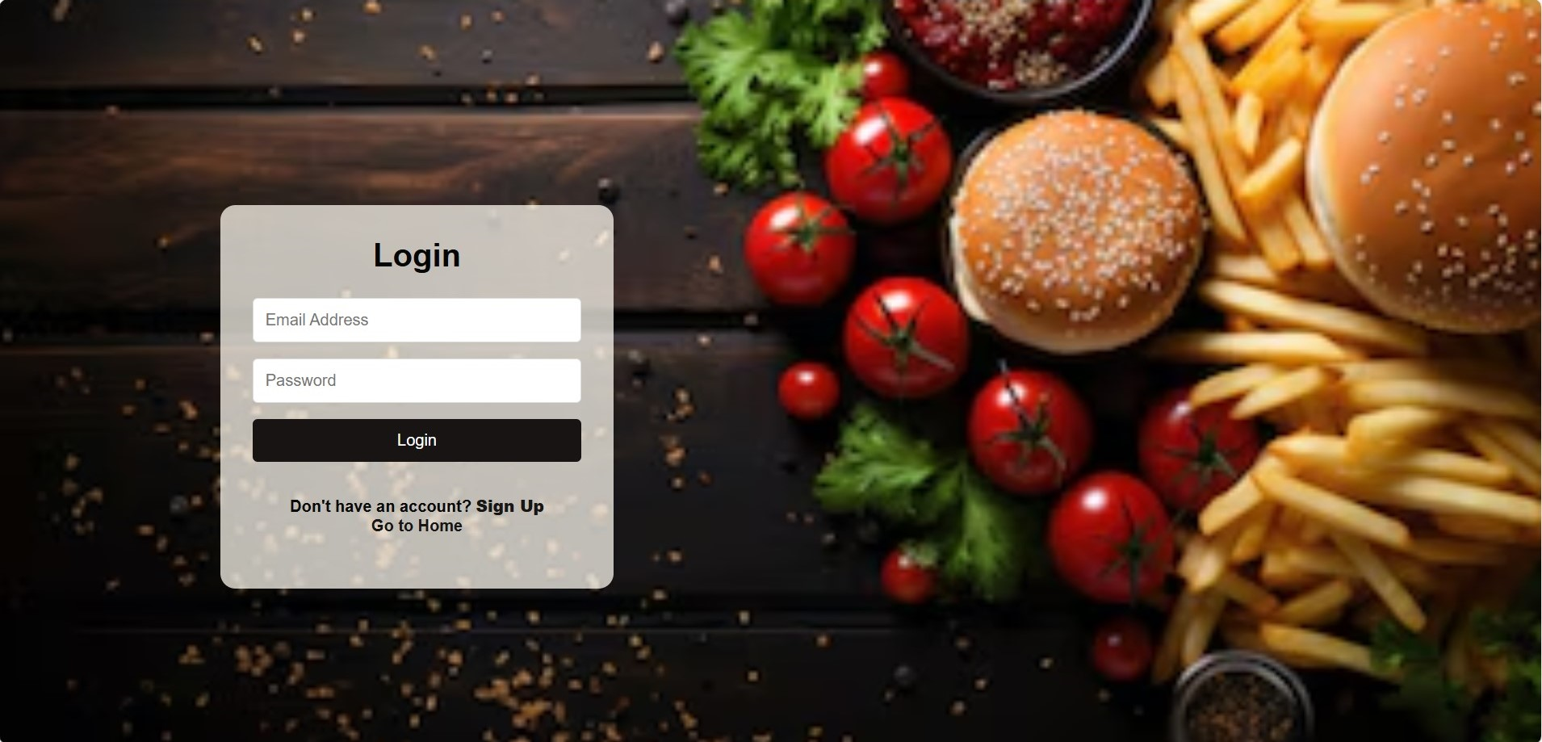
Login Page

Slide 8
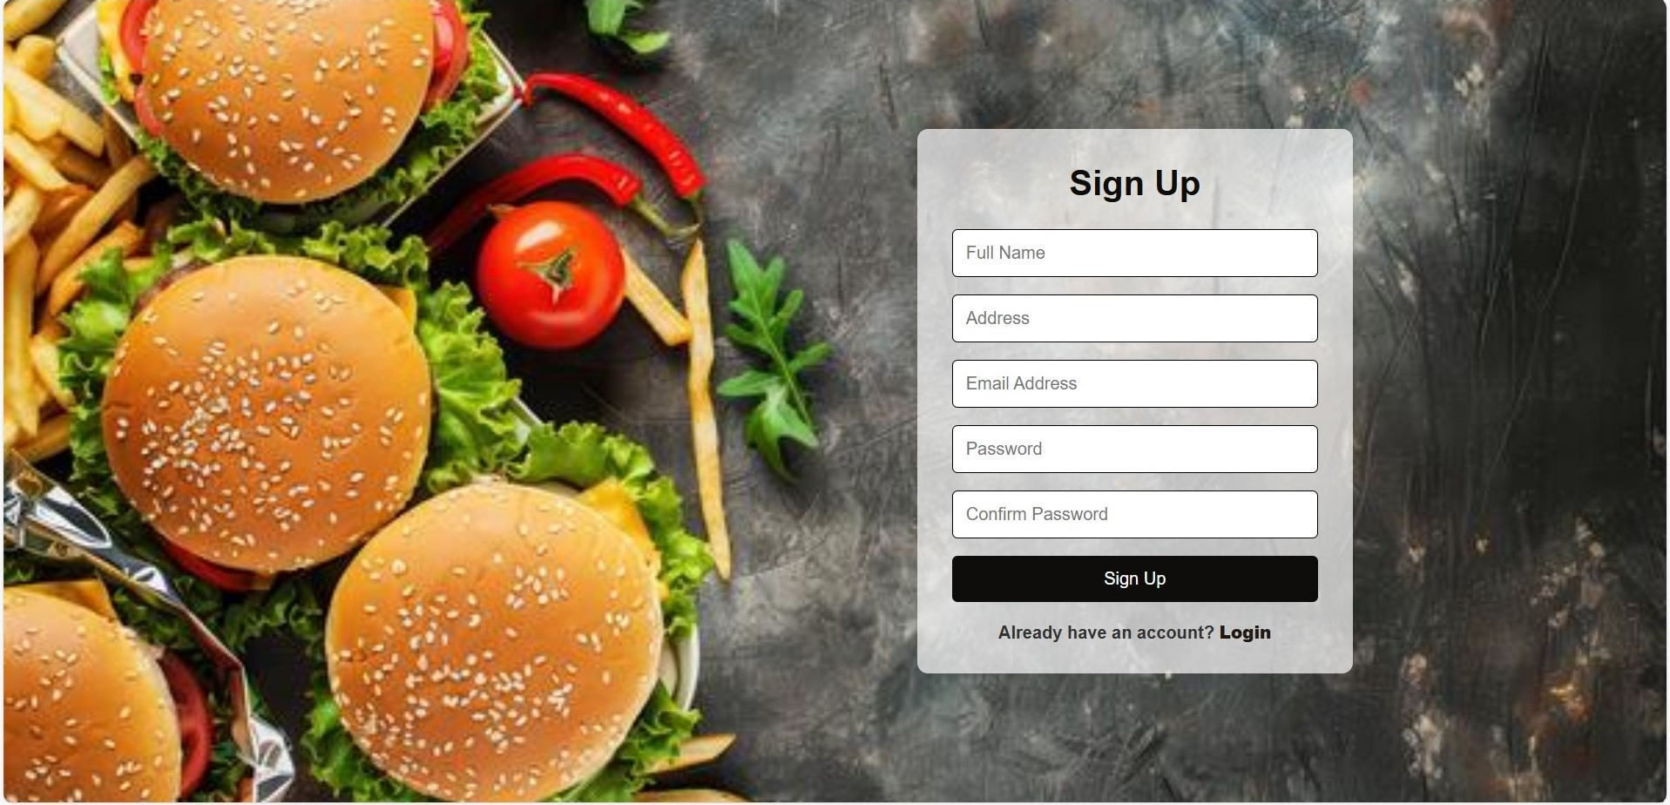
Sign Up Page

Slide 9
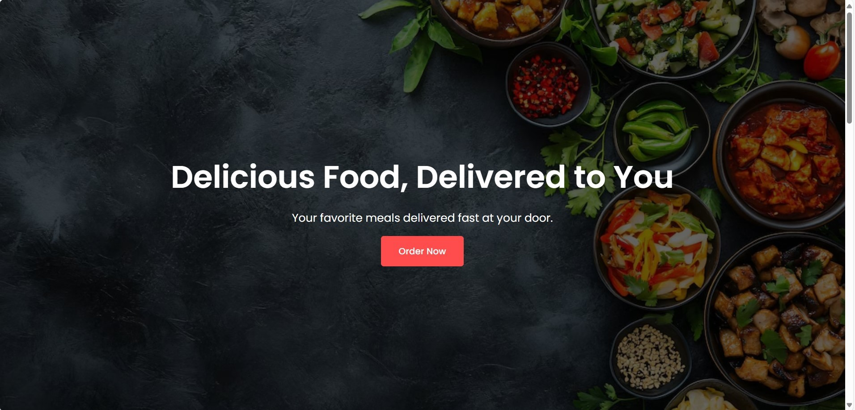
Home Page

Slide 10
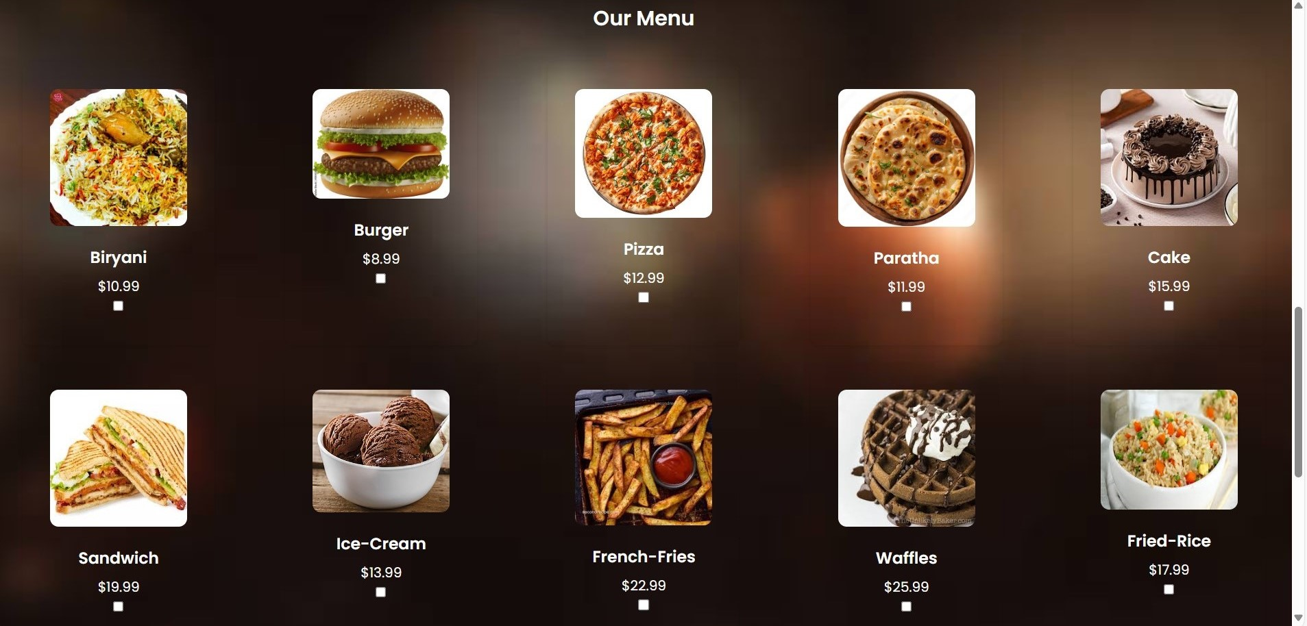
Menu Page-1

Slide 11
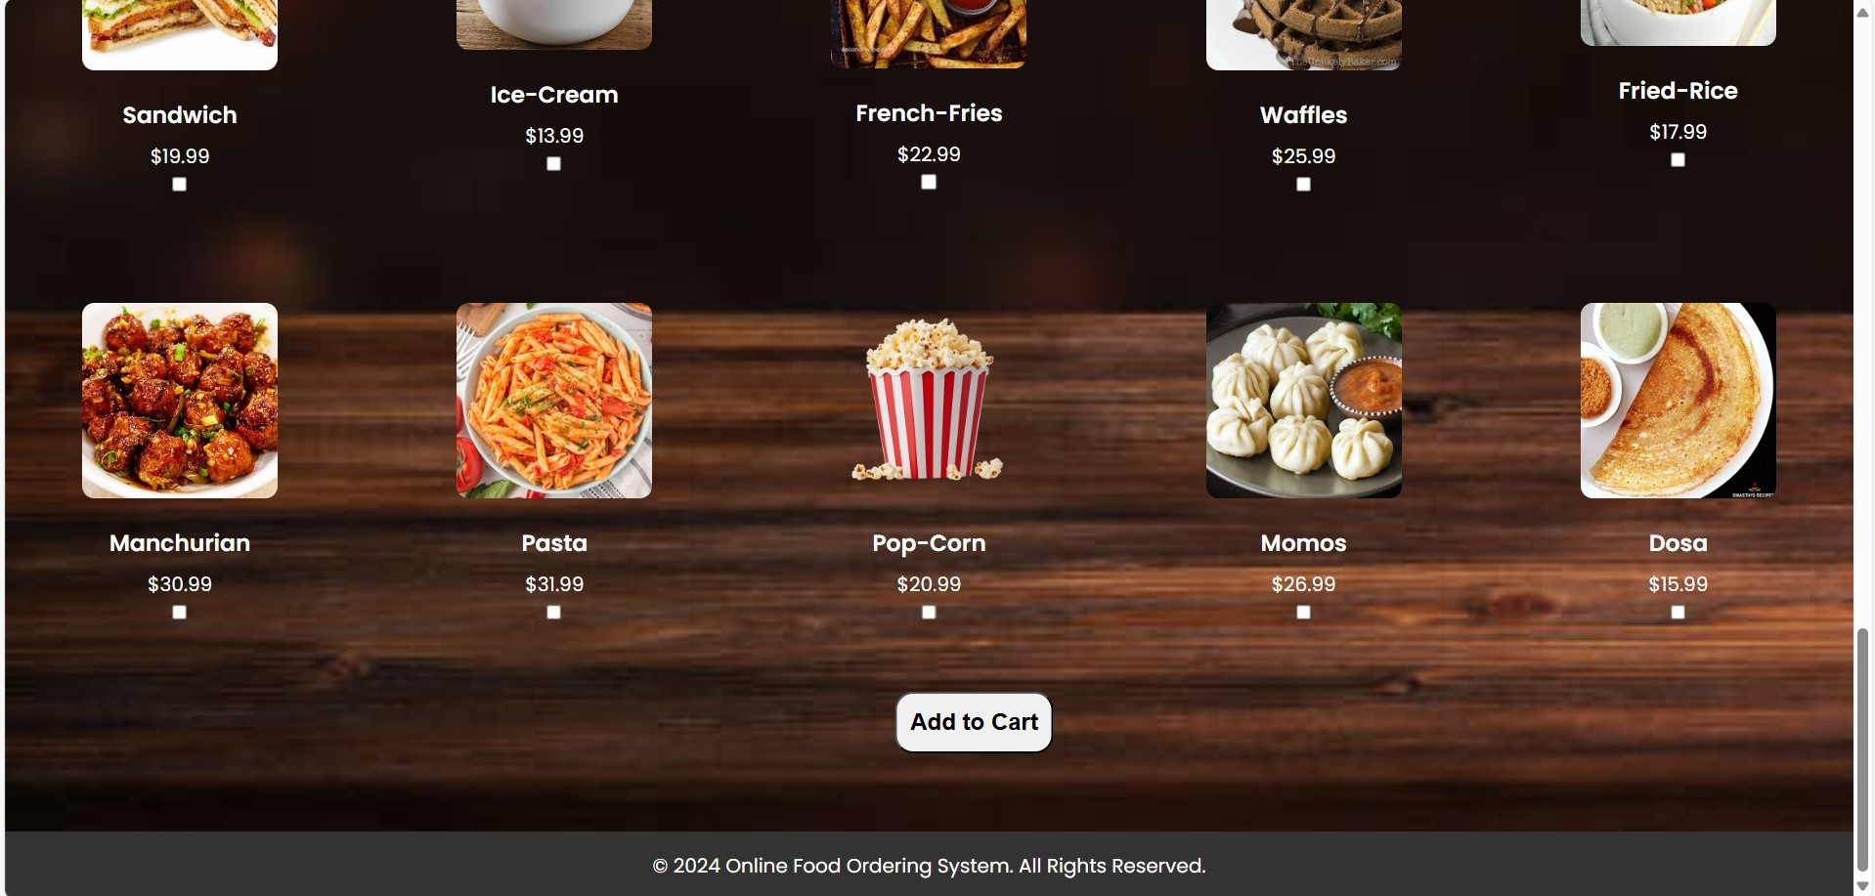
Menu Page-2

Slide 12
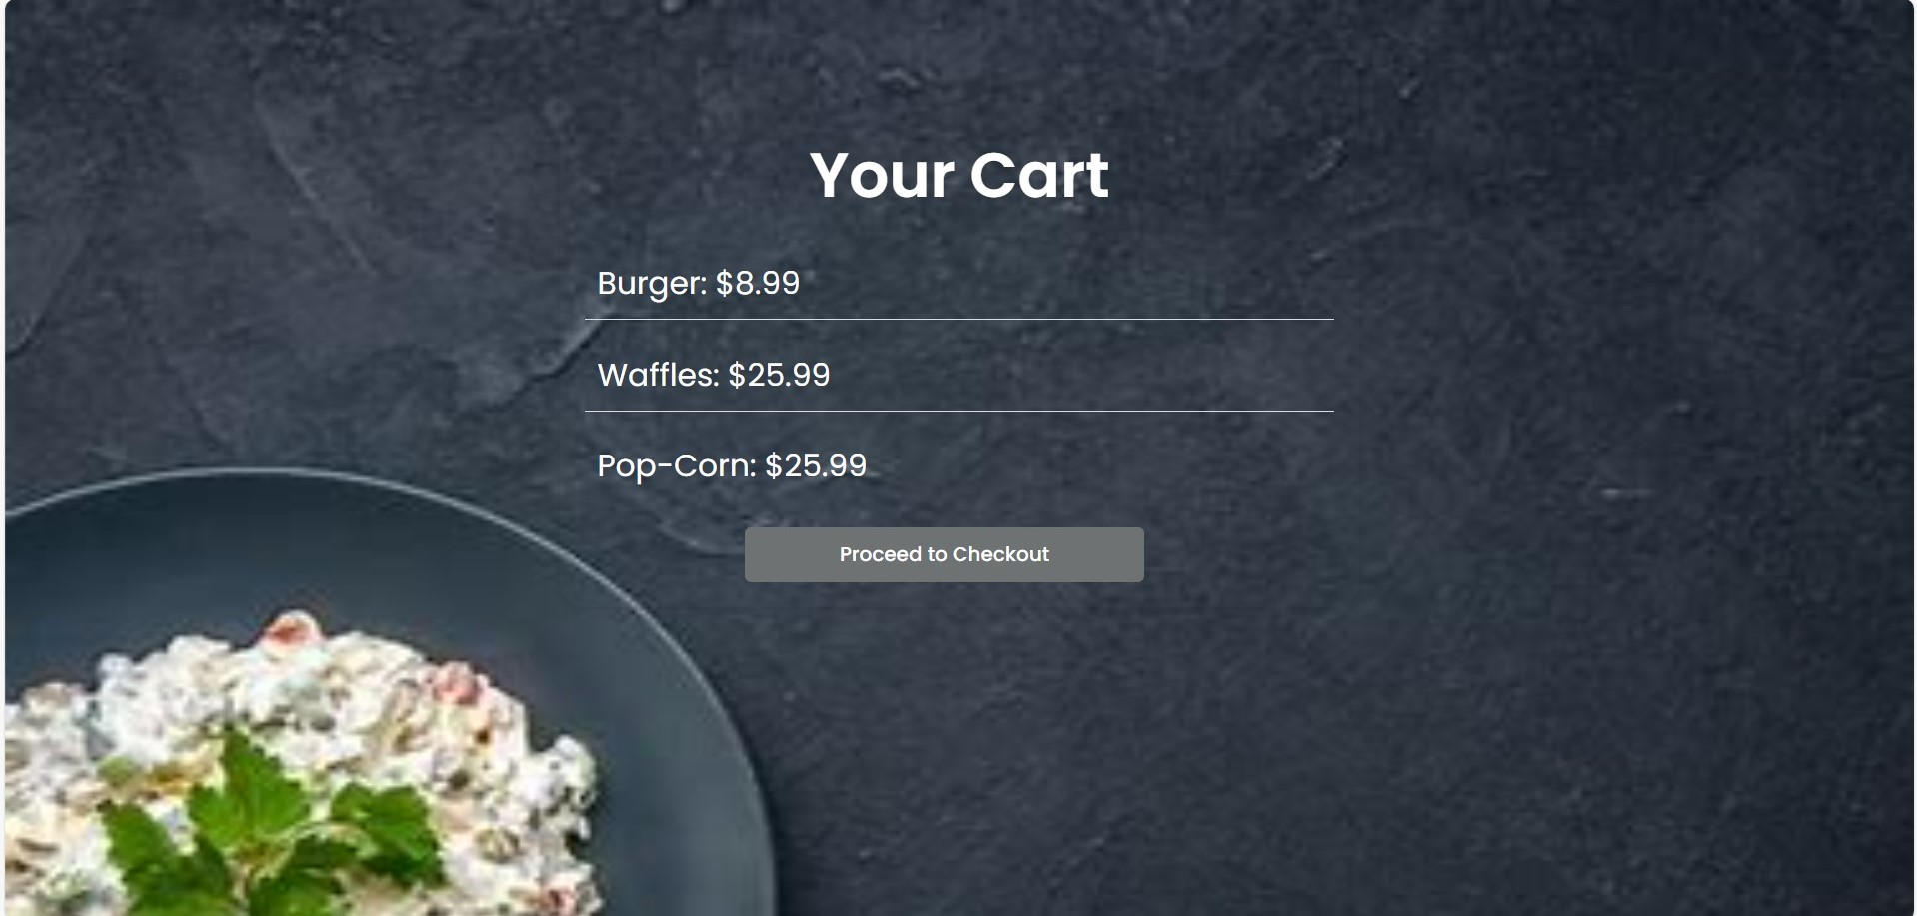
Cart Page

Slide 13
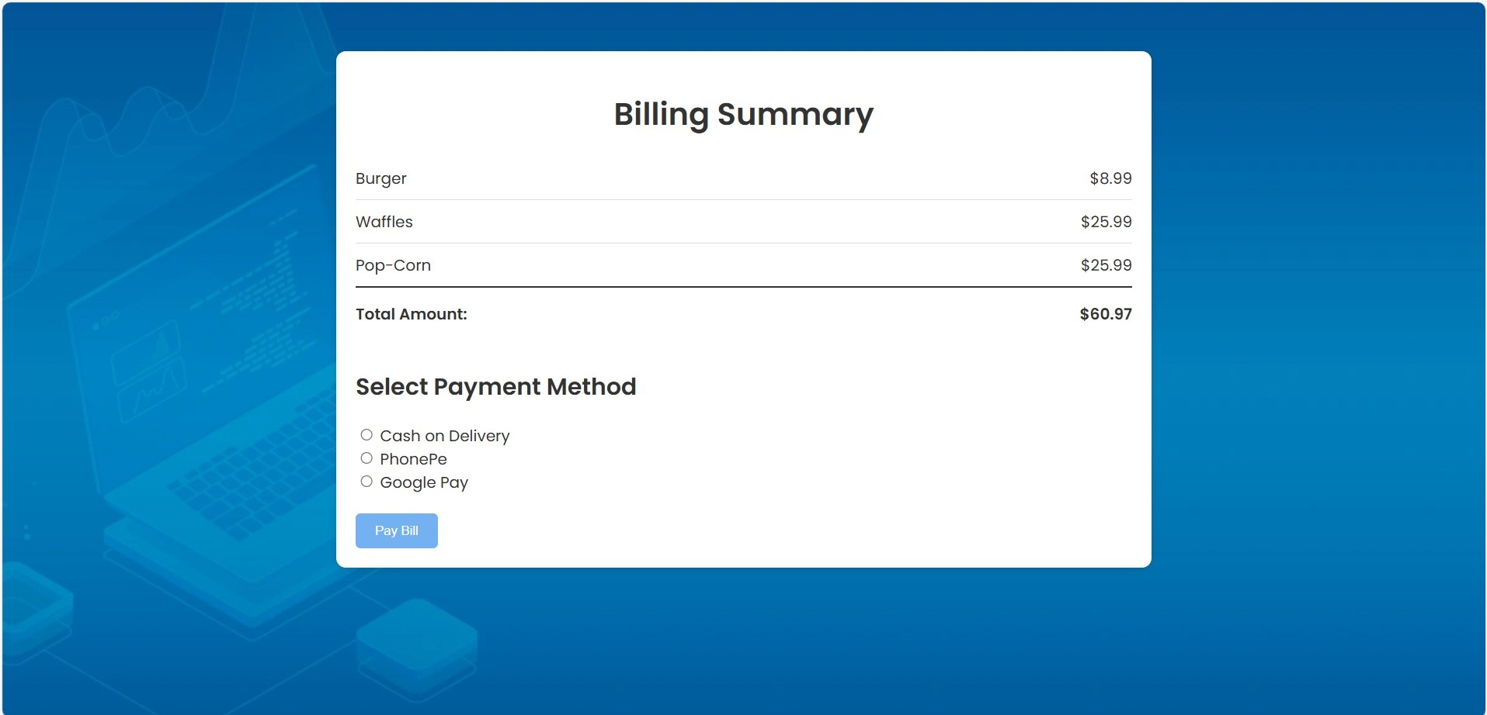
Billing Page

Slide 14
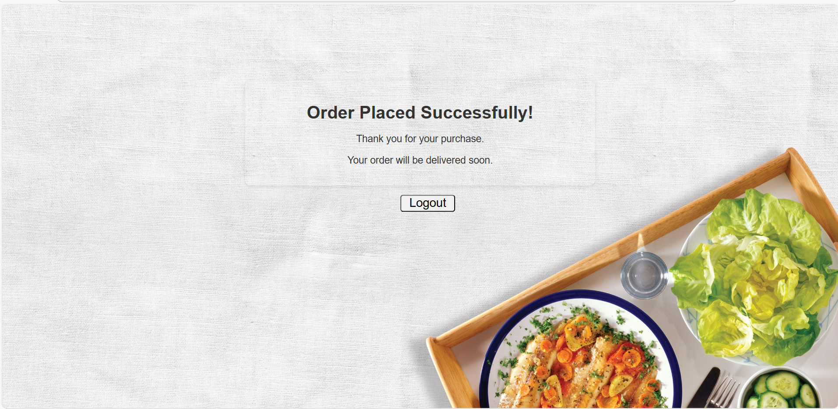
Logout Page

Slide 15
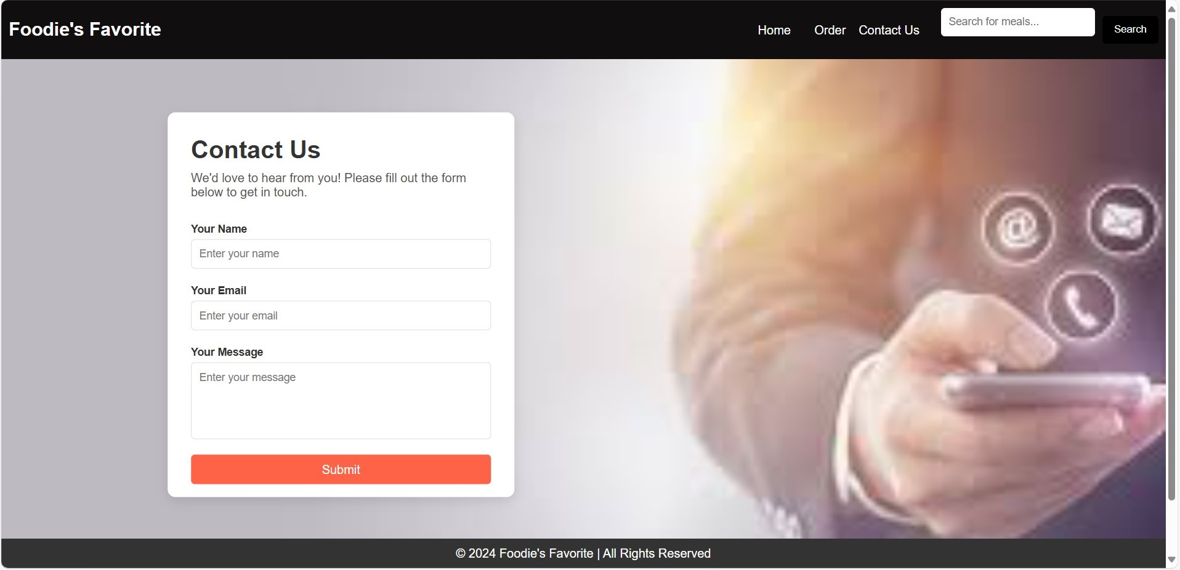
Contact Us Page

Slide 16
Steps To LOGIN OUR WEBSITE
User can login
While logging user needs to provide his/her Email and Password.
If the user is having the account he/she can sign in with the Email and Password.
User can go the home page and can check menu which are present in our website.
User can select number of food items he/she wants.
Once user selects those food items then user can click on add to cart button.
Add to cart page shows the food items that user has selected in menu page.
Once User clicks on Proceed to Checkout button, then it goes to Billing page.
In Billing Page, it shows the total amount of food items.
User can select any one of payment: COD or G pay or Phonepe.
Admin has to login with his Credentials
Admin can able to see the order details of user.
If any support from us user can also use contact us page.

Slide 17
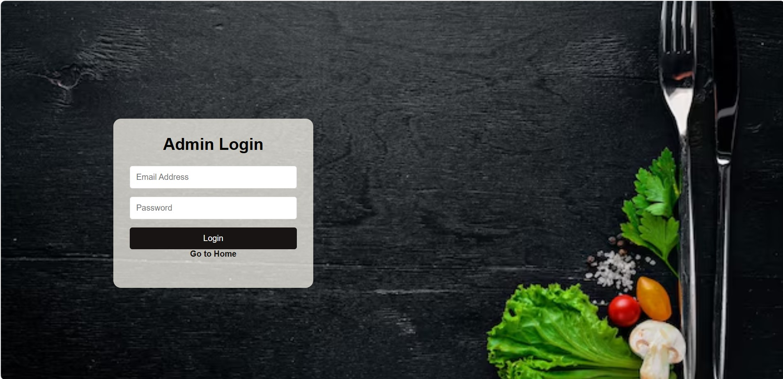
Admin Login

Slide 18
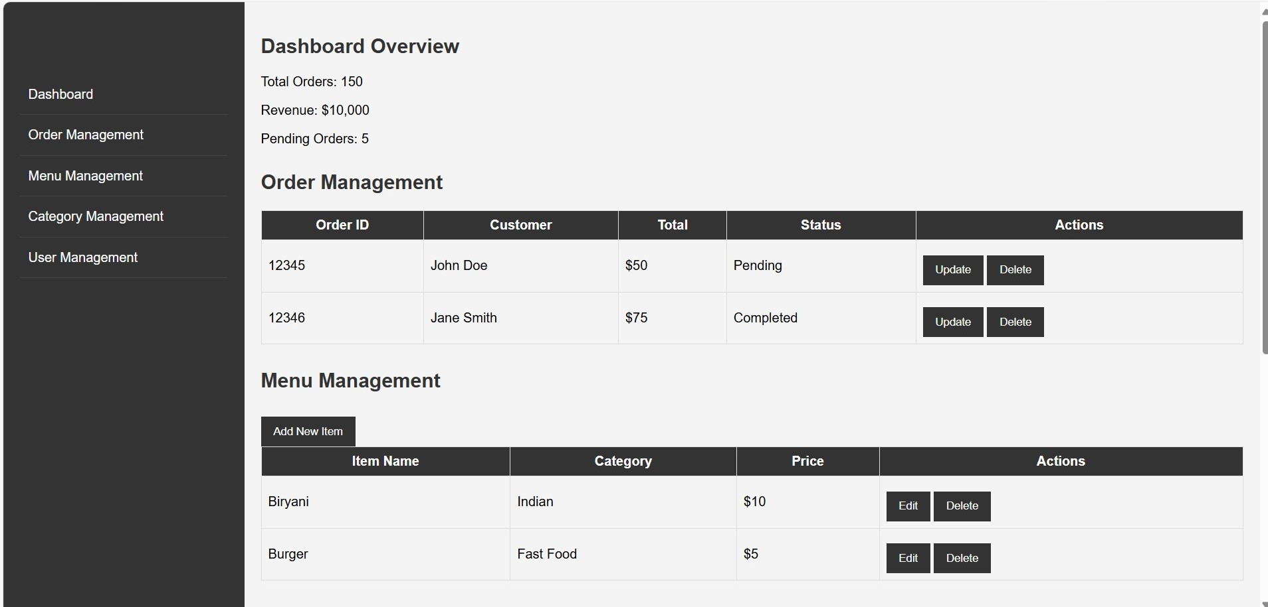
Admin Page-1

Slide 19
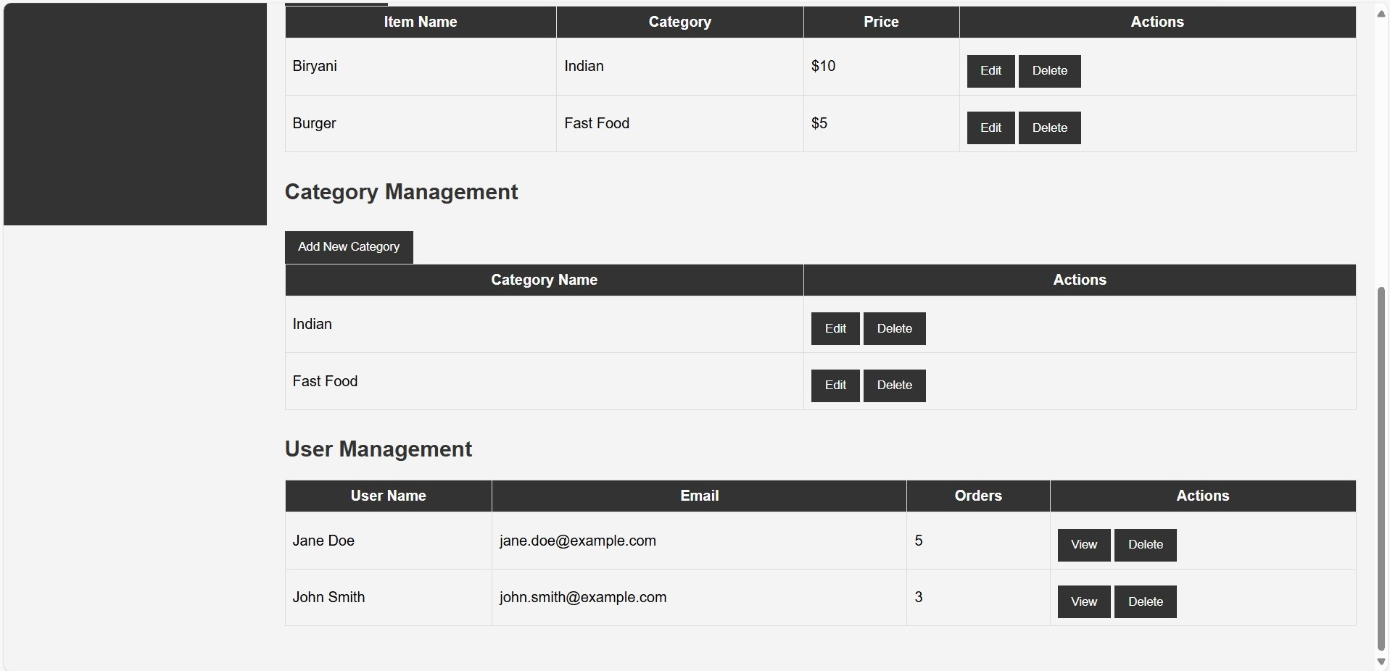
Admin Page-2

Slide 20
Convenience: Clients can place orders from any location without necessarily visiting the restaurant regardless of the time of day. This feature is highly appreciated during the case of very late hours or bad weather. Variety and Options: Most of the time, online menus available offer all the items including the option of customizing a certain item (toppings and add-ons for instance) which widens the customers’ choices. Simple Payment Methods: availability of credit/debit cards, cash on delivery, and mobile wallets, the customers are provided with the convenience in the payment processes. Tracking of Orders: Most of the online systems allow the users to track the status of their order and even the stage which their food is and when it is being delivered. Offers and Deals: Several online management systems have been found to provide such loyalty schemes in the form of discounts, coupons or even loyalty points which make them go back for business.
BENEFITS OF ONLINE FOOD ORDERING

Slide 21
CONCULSION
the evolution of the internet has led to advancements in food ordering systems both for the end user and the restaurant management. It enhances the experience of customers by making it easy and fast to select their preferred meals, further personalized within the available meals. Whereas, it streamlines the processes for the restaurant cutting down order taking and stock monitoring mistakes, thus improving efficiency of restaurant operations.

Slide 22
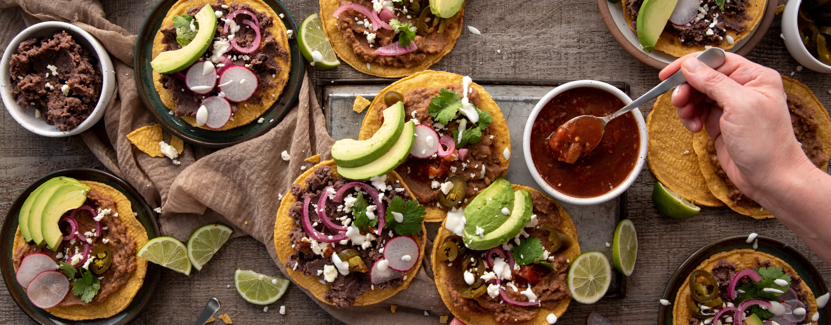
THANK YOU
Foodie’s Favorite

